Slide 1
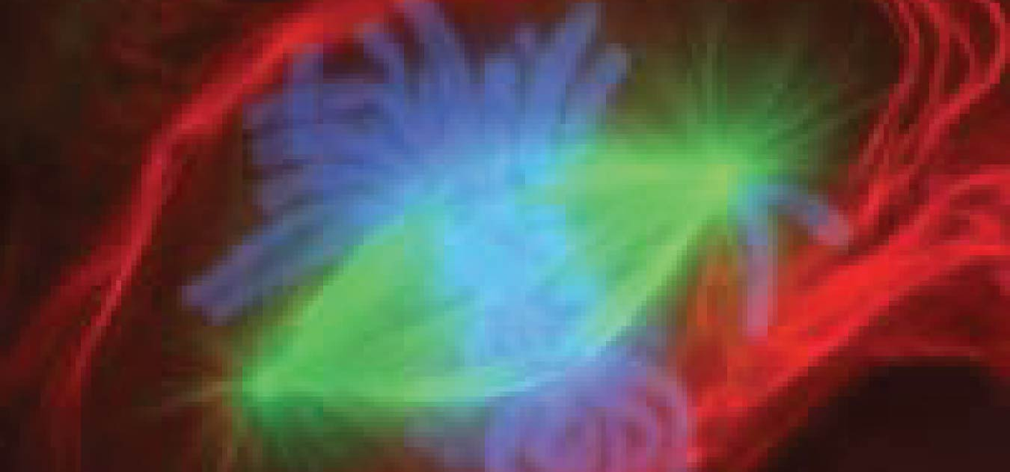
The Cellular Level of Organization
OpenStax Anatomy and Physiology – Chapter 3

Slide 2
The Cell Membrane: Objectives
Describe
Describe the molecular components that make up the cell membrane
Explain
Explain the major features and properties of the cell membrane
Differentiate
Differentiate between materials that can and cannot diffuse through the lipid bilayer
Compare and contrast
Compare and contrast different types of passive transport with active transport, providing examples of each

Slide 3
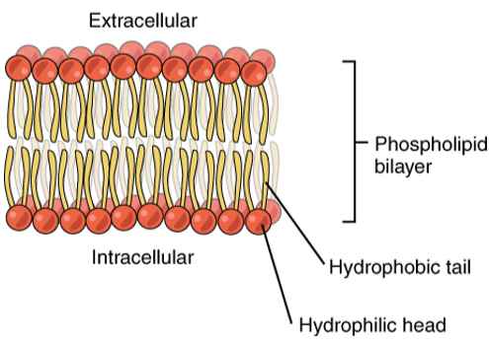
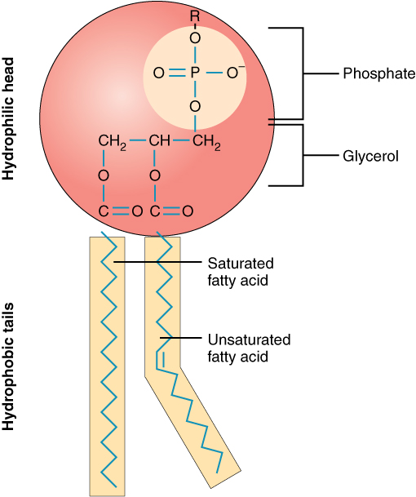
Membrane structure
Phospholipids
Lipid bilayer
Interstitial fluid

Slide 4
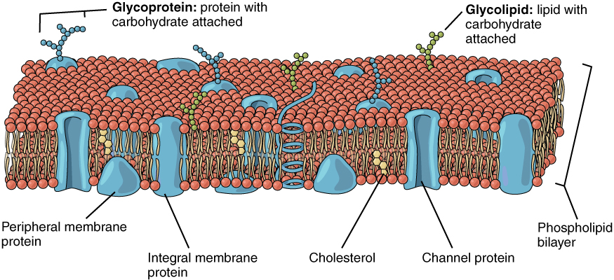
Membrane proteins
Types of proteins
Integral
Peripheral
Glycoproteins
Channel
Receptors and Ligands
Glycocalyx

Slide 5
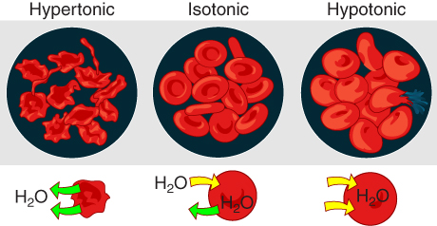
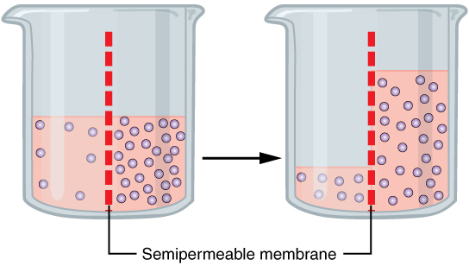
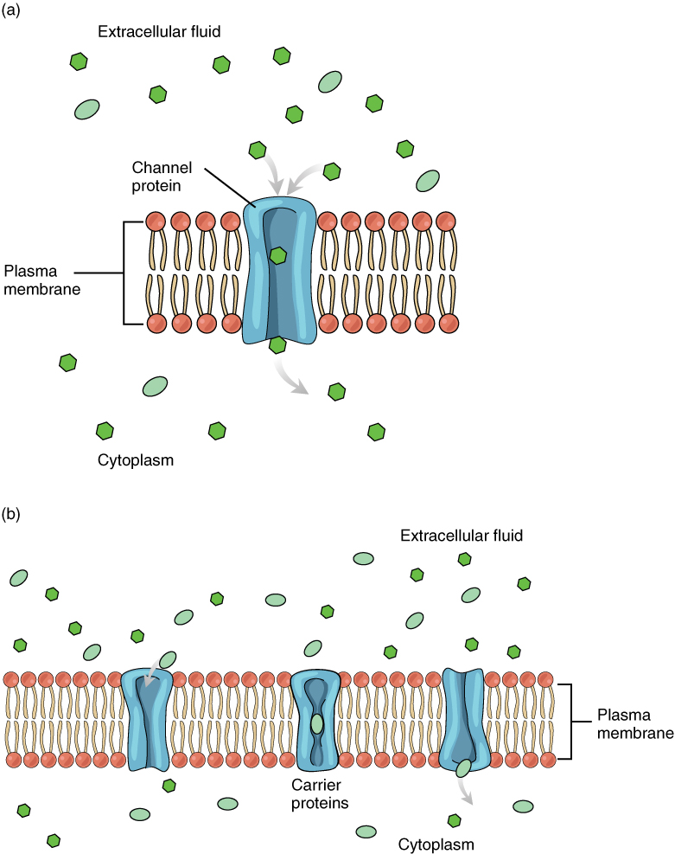
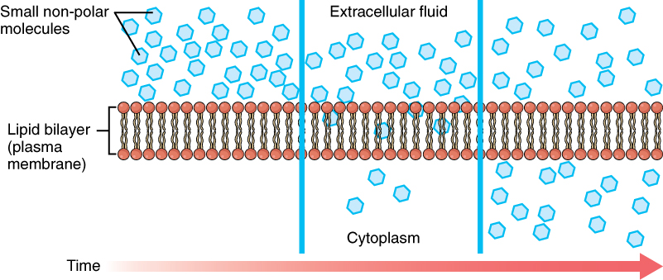
Membrane Transport : Passive
Selective permeability
Diffusion
Facilitated diffusion
Osmosis
Isotonic
Hypotonic
Hypertonic
Examples in the body?

Slide 6
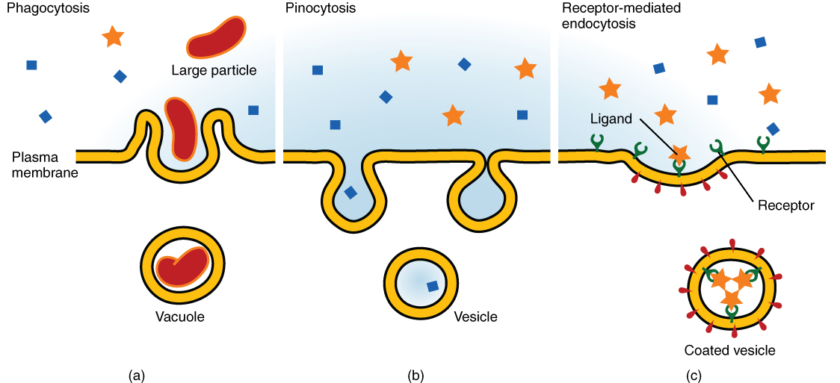
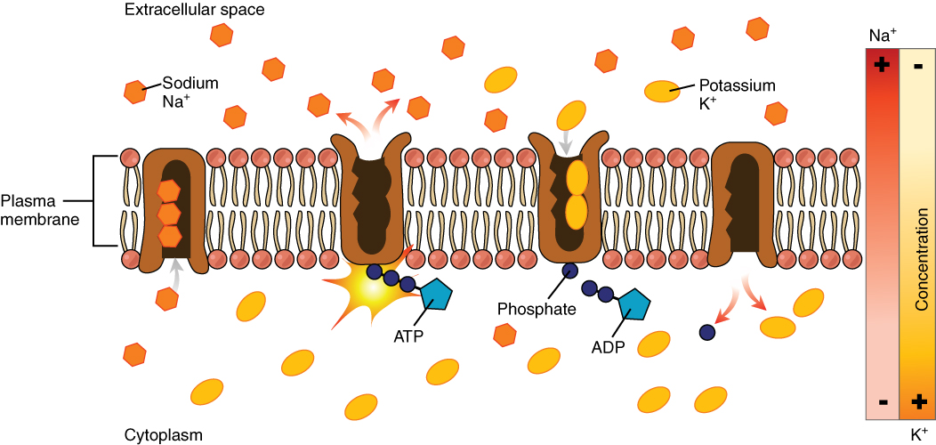
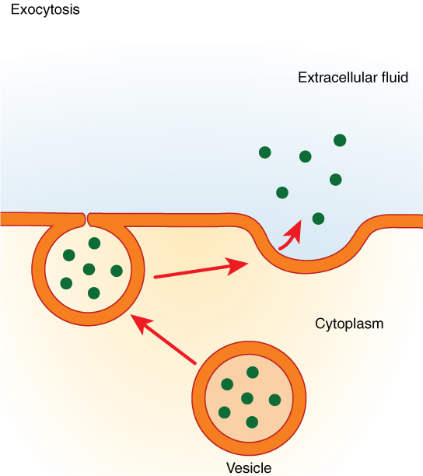
Membrane Transport: Active
Sodium-Potassium Pump
Endocytosis
Phagocytosis
Pinocytosis
Receptor-mediated endocytosis
Exocytosis

Slide 7
The Cytoplasm and Cellular Organelles: Objectives
Describe
Describe the structure and function of the cellular organelles associated with the endomembrane system, including the endoplasmic reticulum, Golgi apparatus, and lysosomes
Describe
Describe the structure and function of mitochondria and peroxisomes
Explain
Explain the three components of the cytoskeleton, including their composition and functions

Slide 8
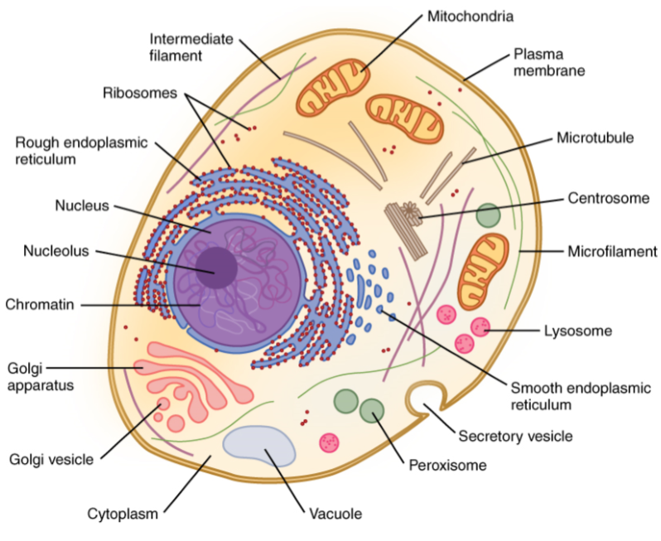
Overview of the Cell
Cytosol + Organelles = Cytoplasm
Lets review basic structure/function

Slide 9
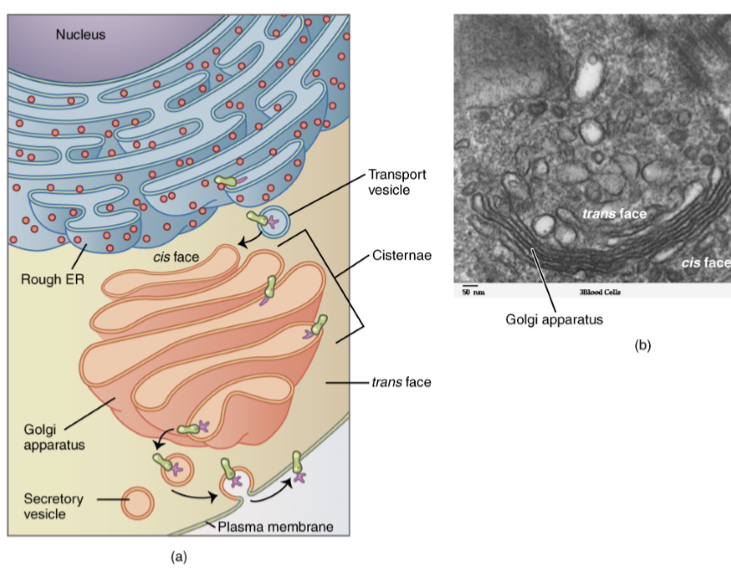
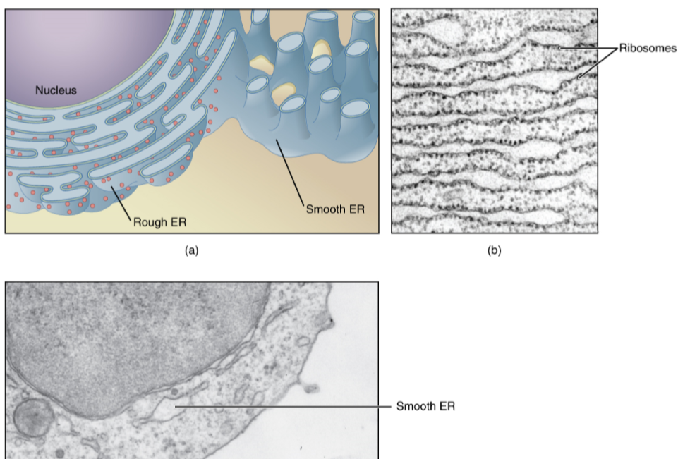
The Endomembrane System
Endoplasmic reticulum
Golgi apparatus
Lysosomes

Slide 10
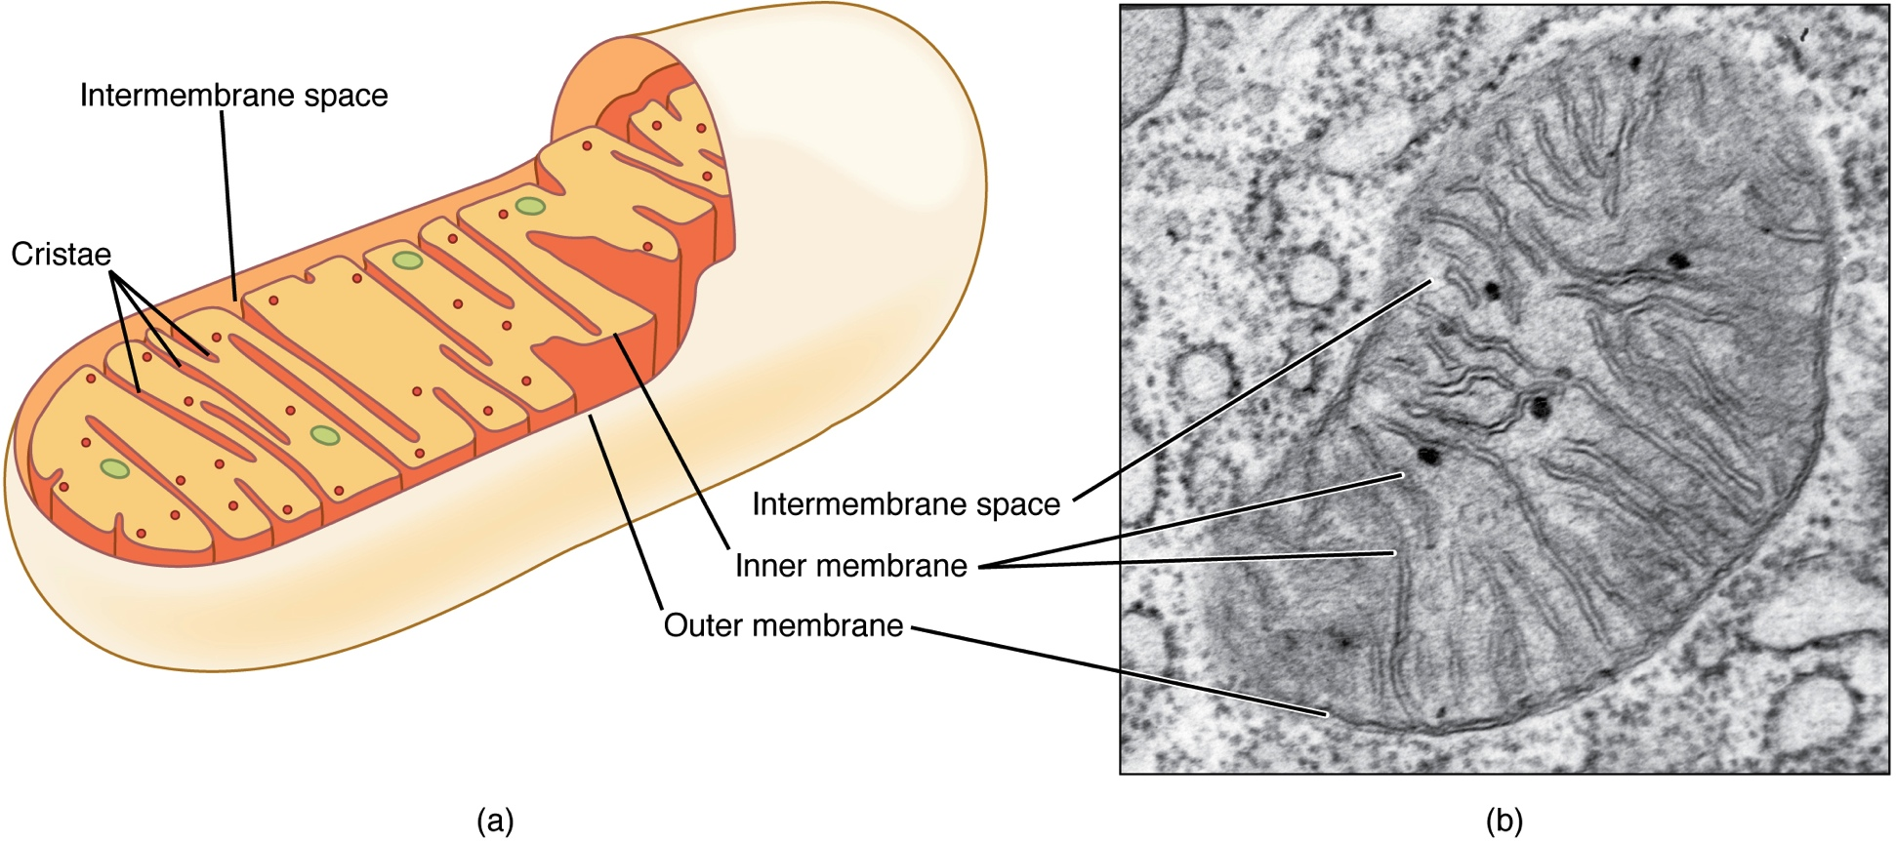
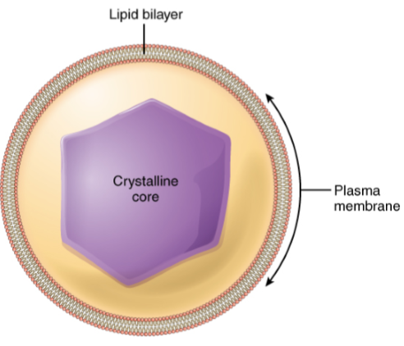
Energy Production and Detox
Mitochondria
Cellular respiration
Peroxisomes
Reactive oxygen species

Slide 11
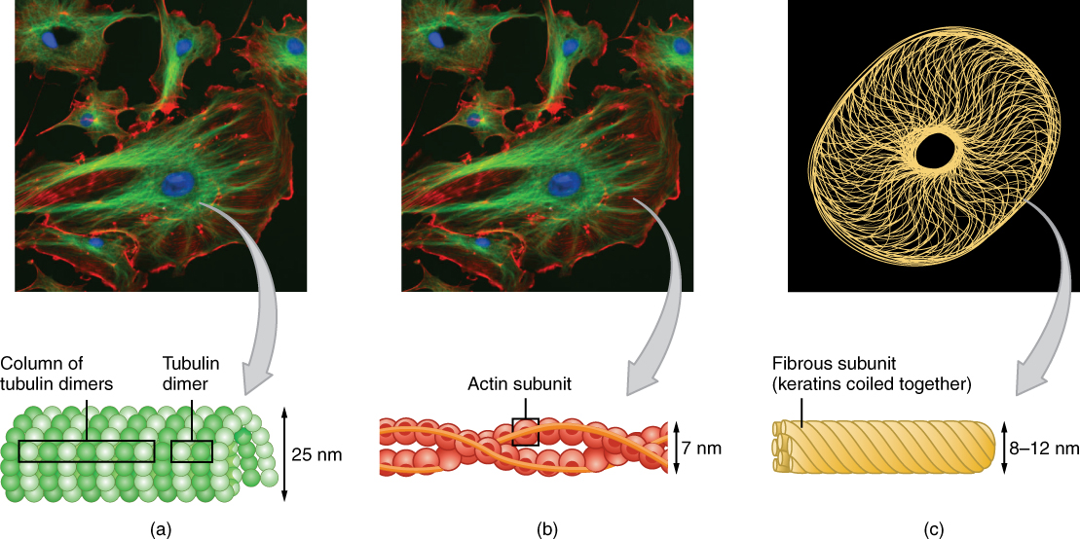
The Cytoskeleton
Provides structural support
Microtubules
Allows movement
Cilia
Flagella
Transport of materials
Muscles

Slide 12
The Nucleus and DNA Replication: Objectives
Describe
Describe the structure and features of the nuclear membrane
List
List the contents of the nucleus
Explain
Explain the organization of the DNA molecule within the nucleus
Describe
Describe the process of DNA replication

Slide 13
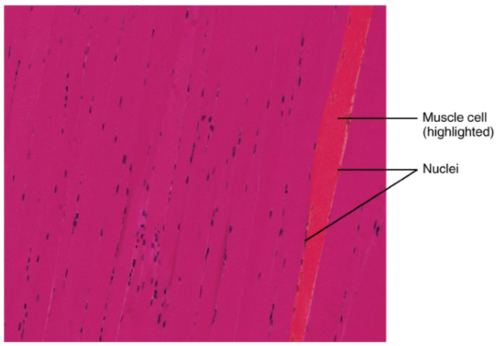
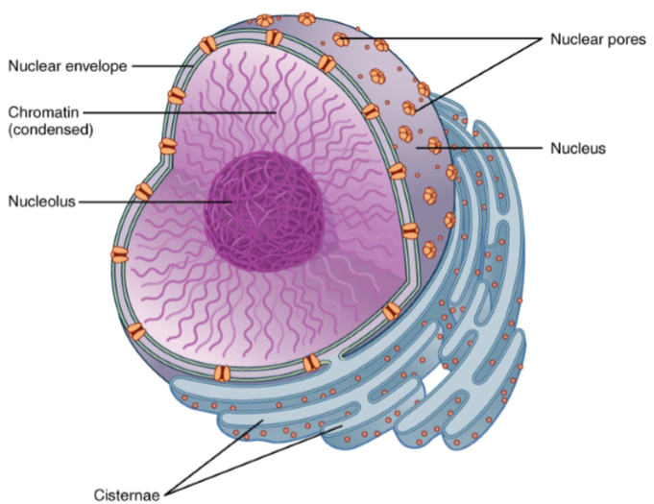
The Nucleus
The “Control-Center”
Largest organelle
Some cells contain multiple

Slide 14
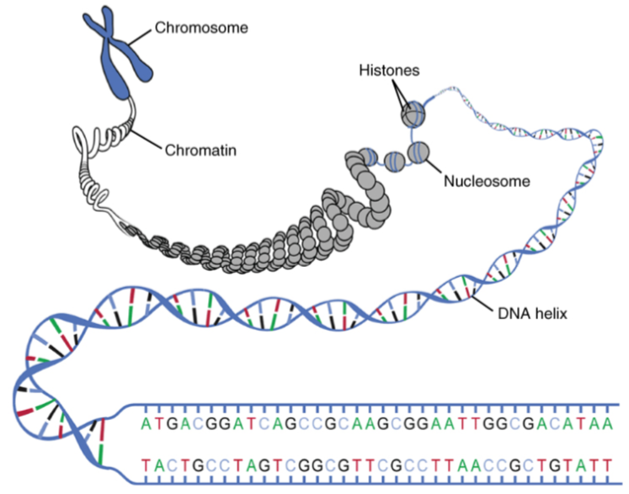
Organization of the Nucleus and DNA
Nuclear envelope & pores
Nucleolus
DNA packaging

Slide 15
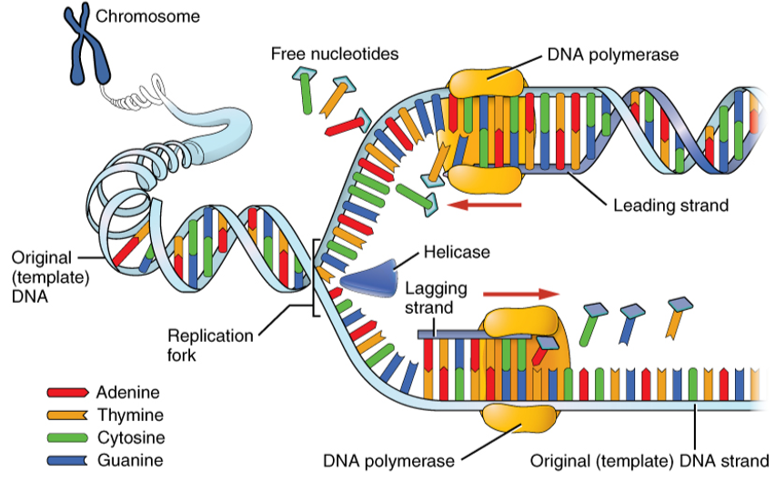
DNA Replication
Three stages
Initiation
Elongation
Termination
Important Enzymes
DNA Polymerase
DNA Helicase
And more….

Slide 16
Protein Synthesis: Objectives
Explain
Explain how the genetic code stored within DNA determines the protein that will form
Describe
Describe the process of transcription
Describe
Describe the process of translation
Discuss
Discuss the function of ribosomes

Slide 17
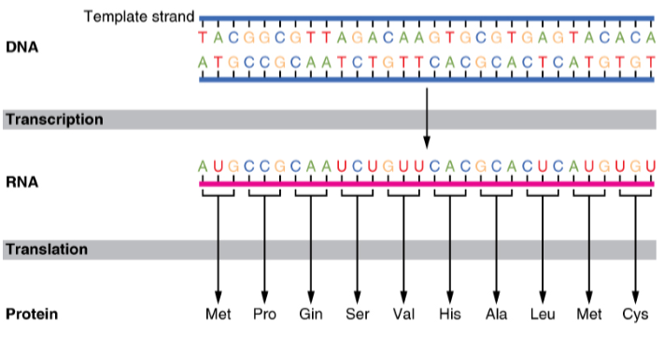
The Genetic Code
Genes and Gene expression
Proteome
Triplets

Slide 18
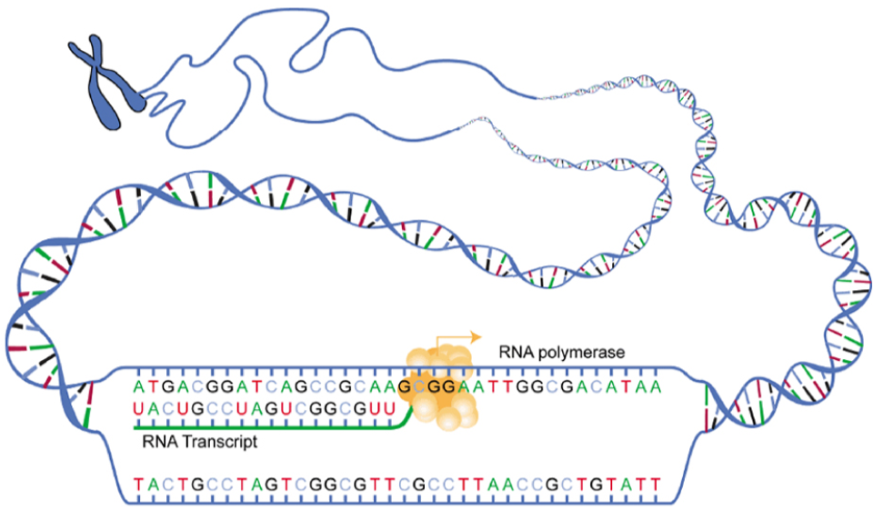
Transcription: DNA to mRNA
Three stages
Initiation
Elongation
Termination
Post processing
RNA splicing

Slide 19
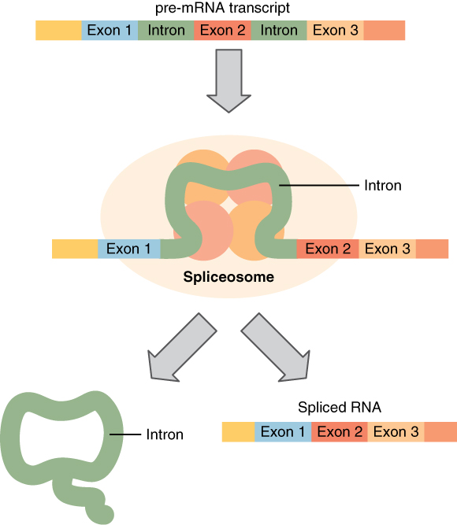
RNA Splicing
Spliceosomes
Cut introns out
Exons remain
Process allows for greater diversity of proteins

Slide 20
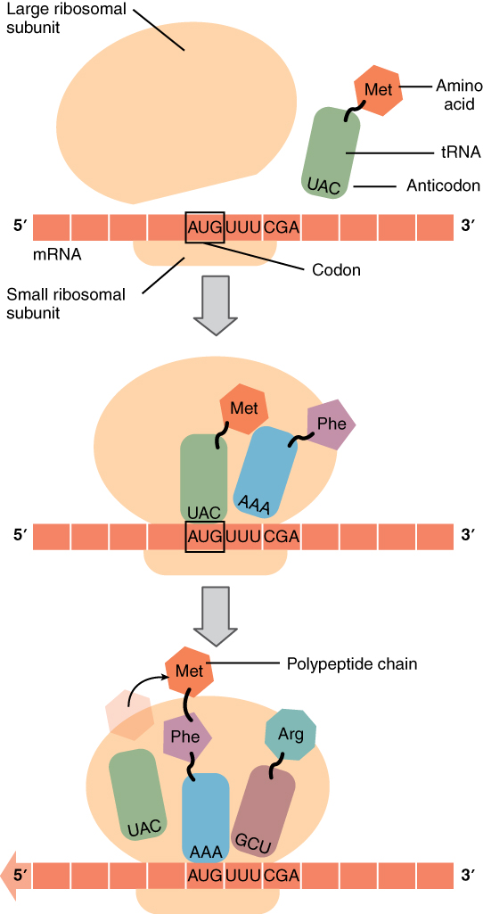
Translation: From mRNA to Protein
tRNA and anticodons
Three stages
Initiation
Elongation
Termination

Slide 21
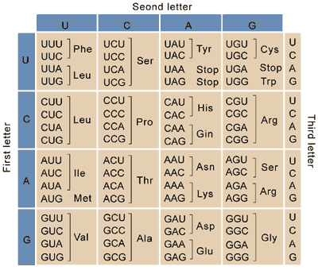
Decoding
Lets practice going from DNA to protein.

Slide 22
Cell Growth and Division: Objectives
Describe
Describe the stages of the cell cycle
Discuss
Discuss how the cell cycle is regulated
Describe
Describe the implications of losing control over the cell cycle
Describe
Describe the stages of mitosis and cytokinesis, in order

Slide 23
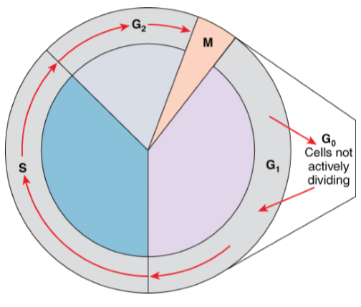
The Cell Cycle
Interphase
G1
S
G2
G0
Mitosis

Slide 24
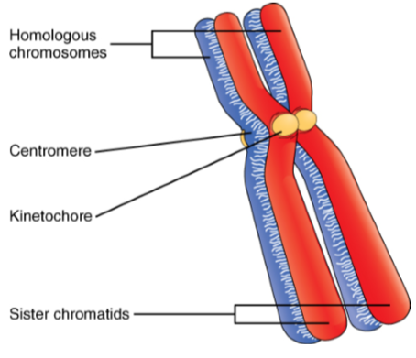
Chromosomes
What do you remember about these?

Slide 25
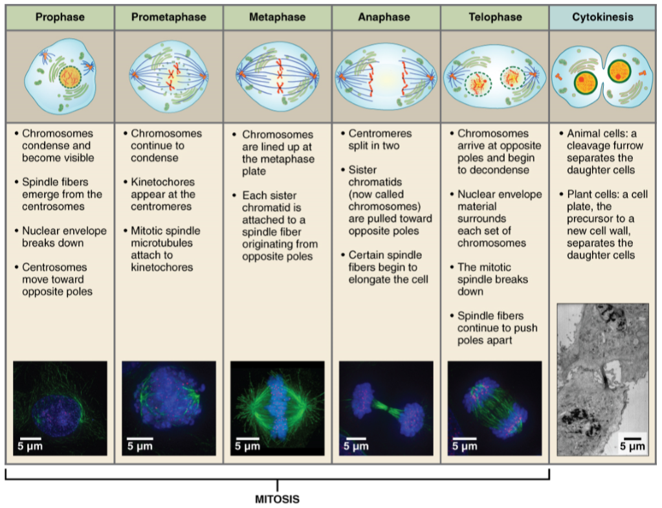
Mitosis
Lets discuss the stages.

Slide 26
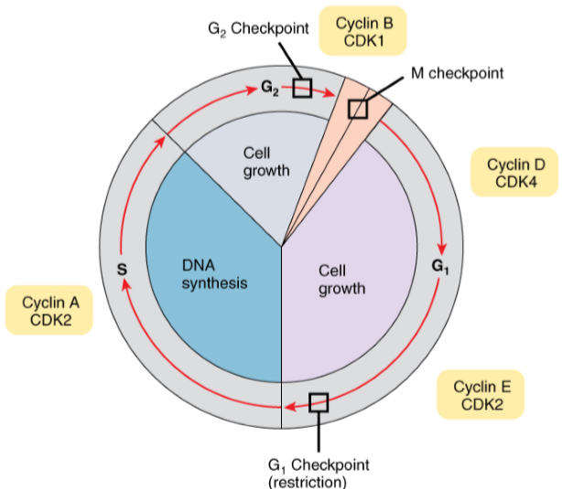
Cell Cycle Control
Cell Checkpoints
Cyclin dependent kinase
Out of control

Slide 27
Cellular differentiation: Objectives
Discuss how the generalized cells of developing embryo or the stem cells of an adult organism become differentiated into specialized cells
Distinguish between the categories of stem cells

Slide 28
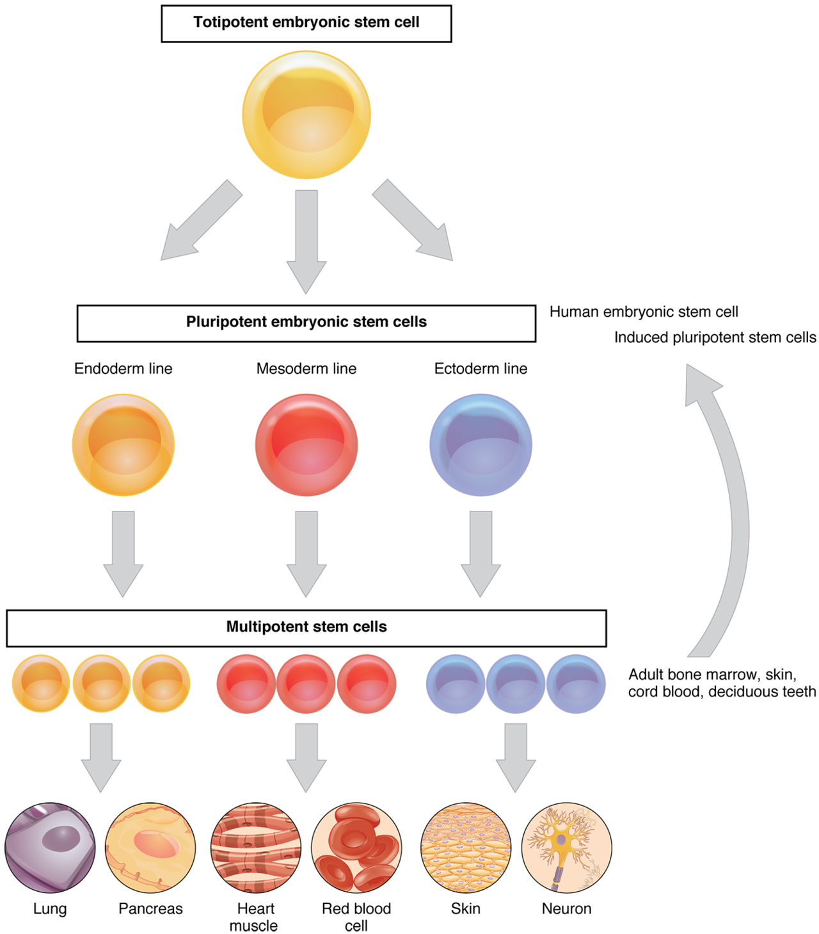
Stem Cells
Totipotent cells
Pluripotent cells
Multipotent cells
Oligopotent cells
Unipotent cells

Slide 29
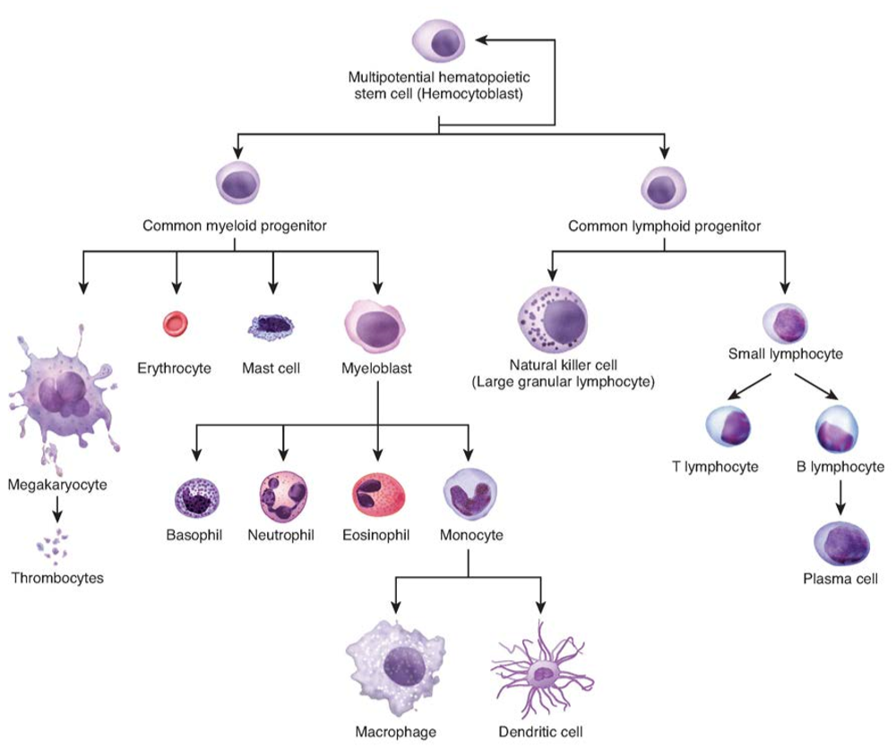
Hematopoiesis
Differentiation of multipotent stem cells into blood cells

Slide 30
Differentiation
Transcription factors
Promote or Inhibit

